Slide 1
Git LFS at a glance

Slide 2
What is git LFS
Git LFS -- Large File Storage
Git LFS is a Git extension developed by Atlassian, GitHub, and a few other open-source contributors, that reduces the impact of large files in your repository by downloading the relevant versions of them lazily.

Slide 3
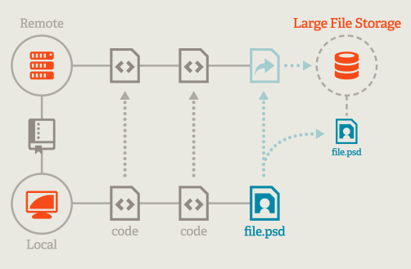
Why using git LFS
Shift the burden of handling large file to the remote server. Local repo does not keep all the file’s version.

Slide 4
How LFS does the magic
Keywords:
LFS filter
Lightweight pointer in local repo.
LFS Cache
LFS Hooks

Slide 5
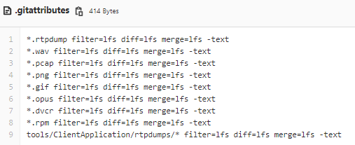
How LFS does the magic – Filter
LFS Filter is used to identify ‘Large File’:
LFS Filter is saved in .gitattributes
LFS filter can be configured through
Use “git lfs track” cmd. E.g. git lfs track “*.wav”
Directly add filter rules in the .gitattributes
Notes:
.gitattributes need to be add/committed
.gitattributes is in a directory other than the root, it will simply cascade downwards

Slide 6

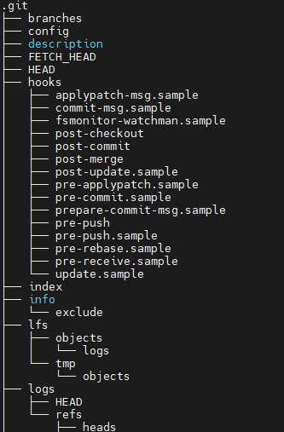
How LFS does the magic – Hook actions
When Git LFS installed, it updates the git hooks.
What Git LFS Hooks Do:
[git add] Git LFS replaces the large files that you try to git add in the repo with pointer files, files that just contain an identifier of the content, and it stores the content files themselves in a separate local folder -- the Git LFS Cache at .git/lfs/objects..
[git push] When you git push your commits, the new large files in the local Git LFS Cache are uploaded to the LFS server separately.
[git checkout] Whenever you do a git checkout, Git LFS will find all the pointer files and replace them with the files themselves, downloading whatever files necessary from the remote server. This means that you only store locally the large files that you actually checkout or that you committed yourself, not all versions of large files in the history of the repo
Reference: How Git LFS Works | Jared Khan

Slide 7
How LFS does the magic – cache/pointer
LFS saves lightweight pointers in place of real file data.
LFS looks up the original file (on the server if it's not local cache) and downloads it

Slide 8
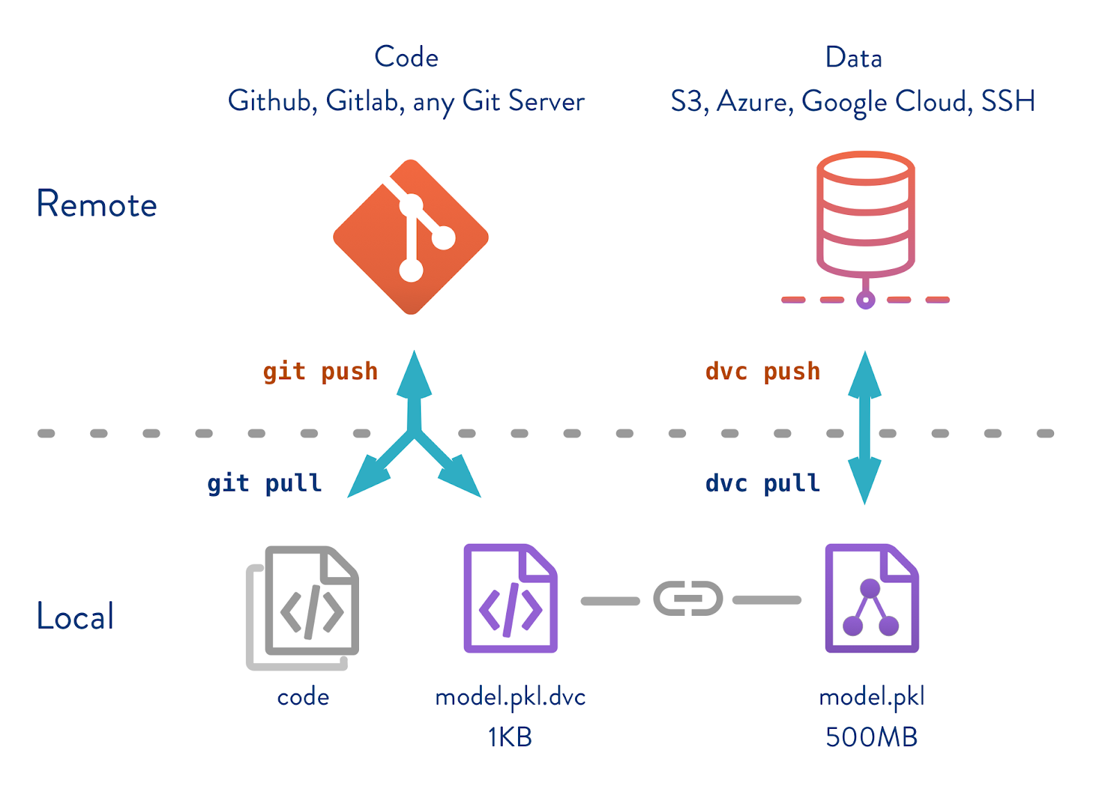
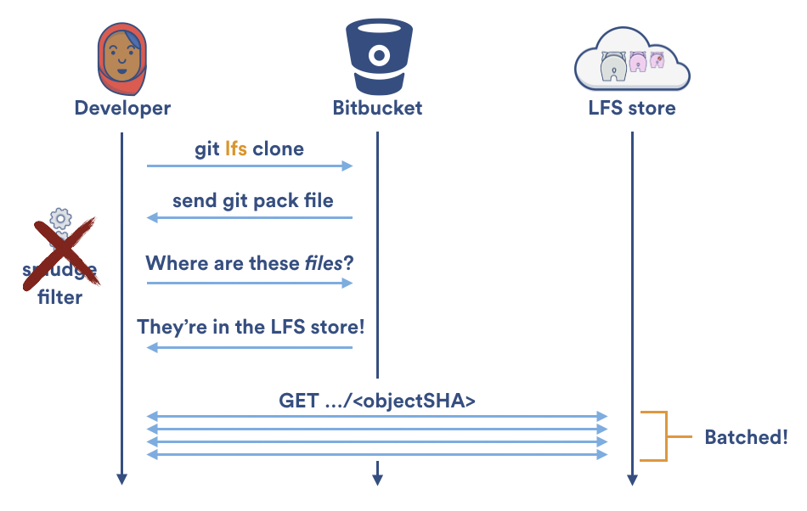
How LFS does the magic – cache/pointer
LFS saves lightweight pointers in place of real file data.
LFS looks up the original file (on the server if it's not local cache) and downloads it
From: Why Git and Git-LFS is not enough to solve the Machine Learning Reproducibility crisis - BLOCKGENI
From: The 2016 Git Retrospective: Git LFS - DZone Agile

Slide 9

How LFS does the magic – cache/pointer
LFS pointer.
# the in-place pointer size is 129
git ls-tree dev/yanxie/gitlab_ci -rl | grep tools/pyapp/please_wait.wav.dvcr
100644 blob 77e94d326010f7471c61b7d24b58ffce56712692 129 tools/pyapp/please_wait.wav.dvcr
# the actual file size 7136
ll tools/pyapp/please_wait.wav.dvcr
-rw-r--r-- 1 yxxie 1049089 7136 Apr 8 10:52 tools/pyapp/please_wait.wav.dvcr

Slide 10
Using LFS
Install git-lfs: sudo apt install git-lfs
Initialize Git LFS: git lfs install
(Only need to run git lfs install once. Once initialized, Git LFS will bootstrap itself automatically when clone a repository containing Git LFS content)
Set filters: git lfs track “<filter>”
Normal git operations (git add, commit, push)
Check lfs status: git lfs status, git lfs ls-files

